Slide 1
Welcome to Online Course Selection
You will need your MyEd Portal login information

Slide 2
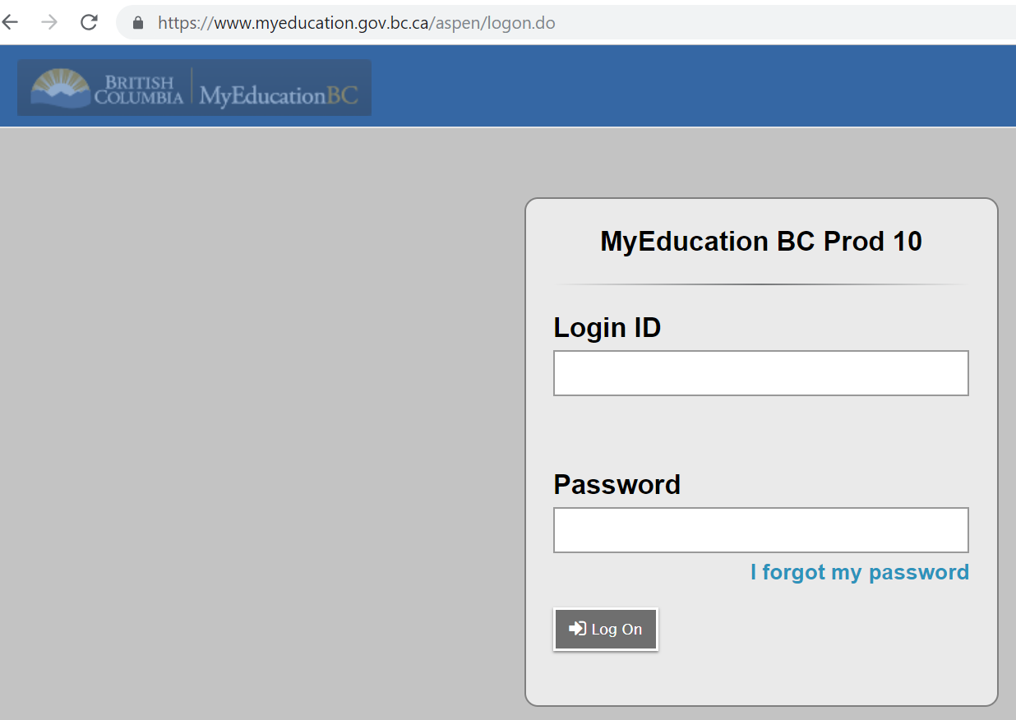
Students need to log on to their MyEdBC account to select their courses for next year

Slide 3
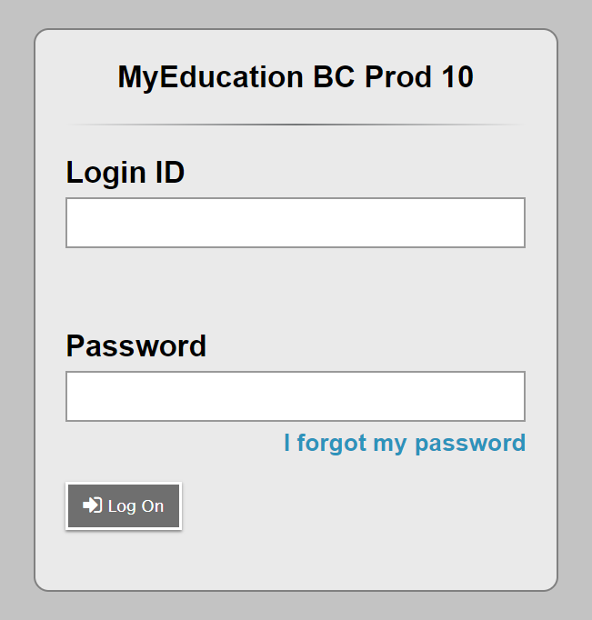
Students need their Student number and their password. Students who have never signed in should use a desk top computer (not their phone) and can obtain their password from their A Block teacher. Use the forgot password button if you can’t remember your PW
Student number
Password
A Block teacher has PW

Slide 4
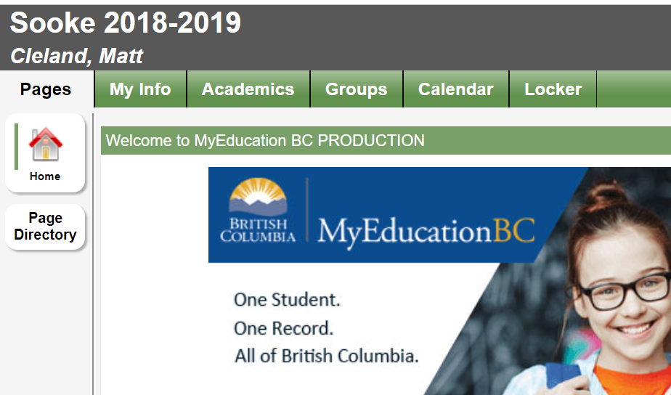
Click My Info
Danger Dan
Students need to click on the My Info tab once they have successfully logged in.

Slide 5
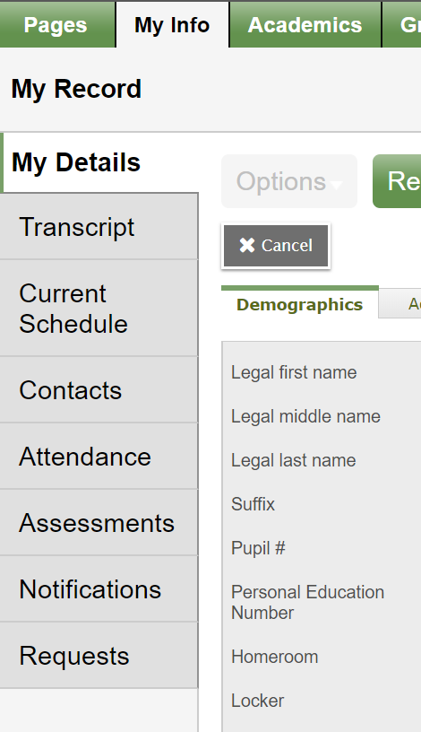
Students should then click on the Requests tab at the bottom left which will take them to the course selection page.
Click Requests

Slide 6
This is the top of the course selection page. Please read all of the instructions carefully and click the link to the course book which has all the course descriptions. This example is for French Immersion.

Slide 7
Clicking the blue Belmont Course Book button will take you here to the course selection guide. Please take the your time to fully inform yourself of all the options available to you.

Slide 8
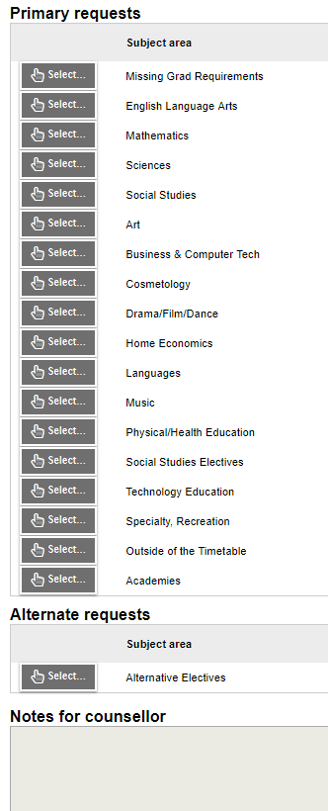
8 Primary Requests
Students will make 8 primary selections, Please start at the top for core subjects and work your way down through all the course selection buttons. Please ensure you select the courses you need for graduation!
Students make 3 alternate requests
3 Alternate Requests

Slide 9
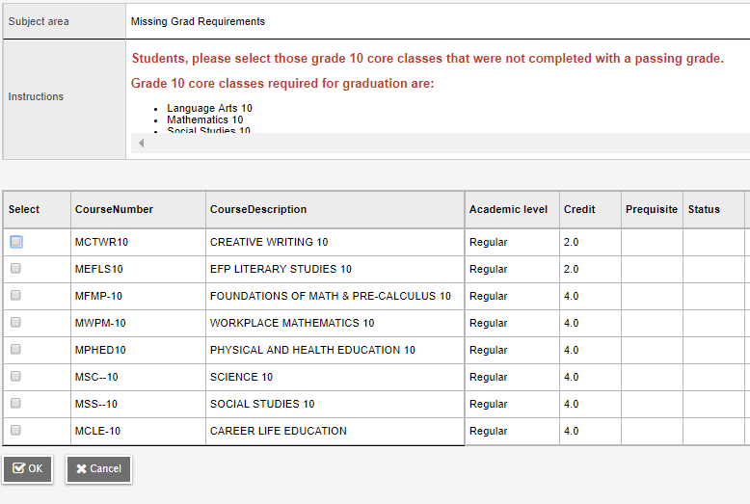
You may need to scroll here to see all the instructions
Please ensure that you have all the necessary courses required for graduation for each grade. You can speak to your counsellor about other options for completing missing requirements.

Slide 10
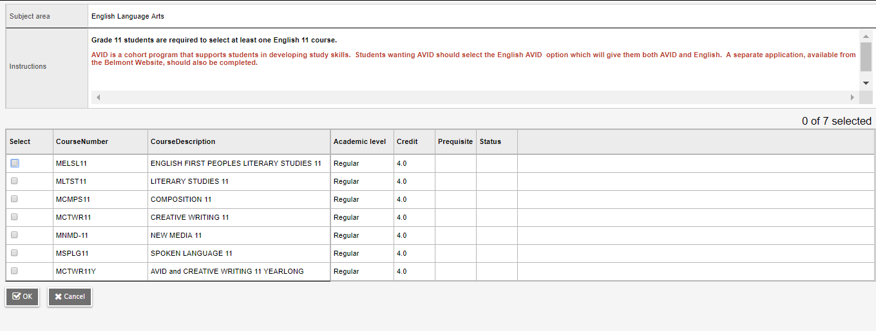
Click to select
Grade 11 students need to take at least one English Language Arts 11 course. Please review the descriptions in the course book.
Students click the box in the left column to select a course followed by the ok button. Remember to click the Post button at the bottom left!

Slide 11
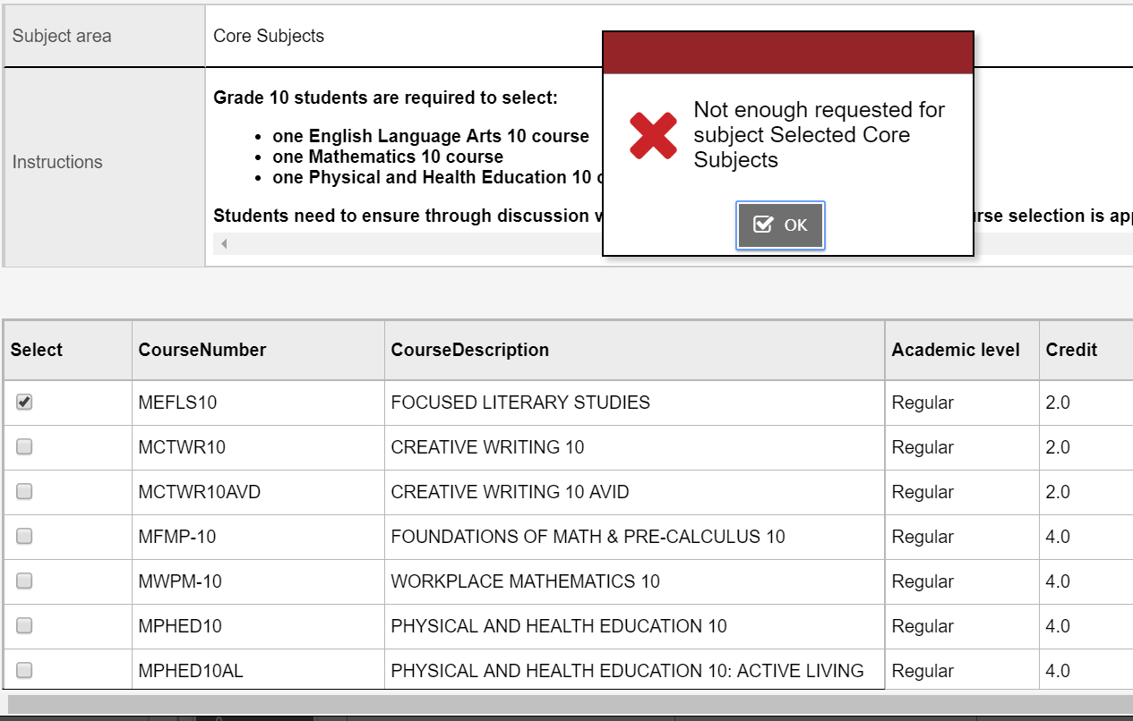
This red banner indicates a mistake.
The red banner indicates a mistake when trying to post while a green banner indicates success!

Slide 12
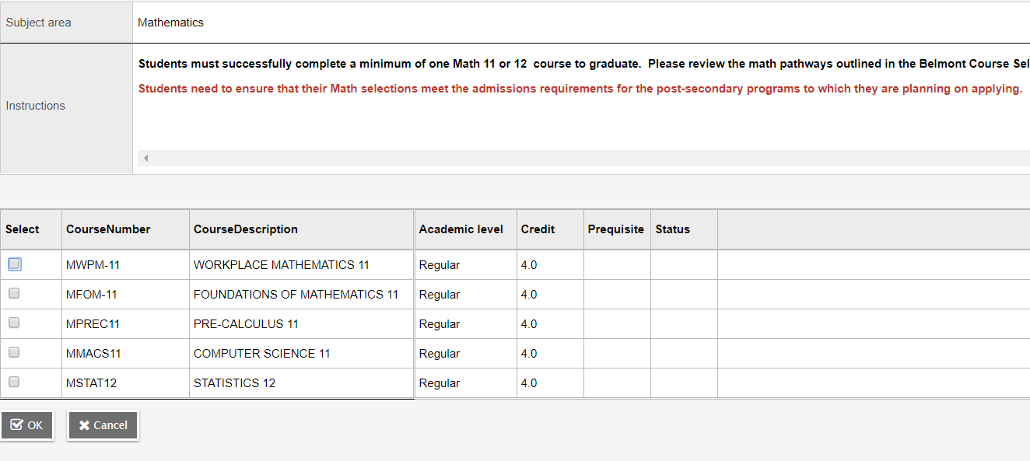
Grade 11 students need to take at least one math 11 course. Please review the descriptions in the course book.

Slide 13
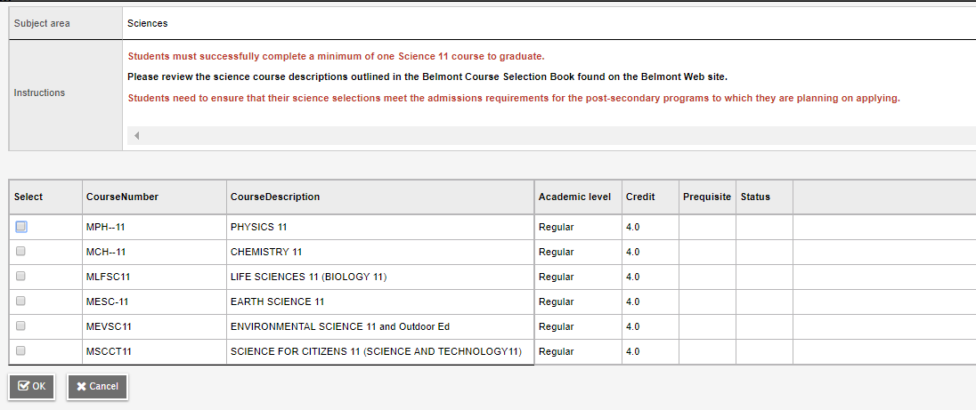
Grade 11 students need to take at least one science 11 course. Please review the descriptions in the course book.

Slide 14
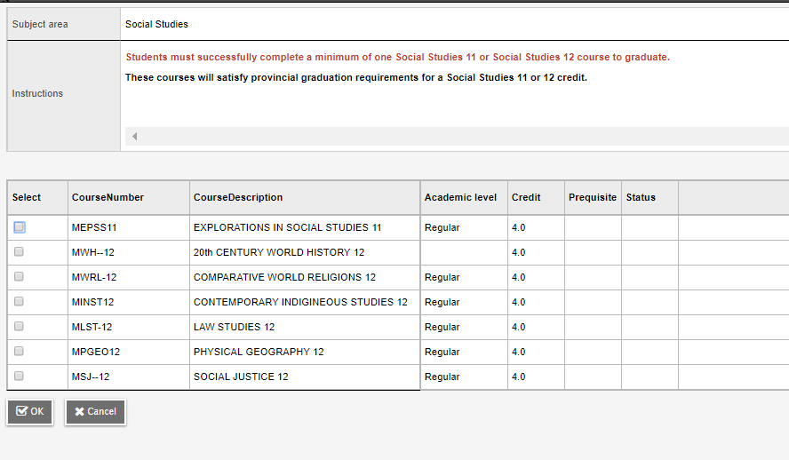
Grade 11 students need to take at least one social studies 11 course. Please review the descriptions in the course book.

Slide 15
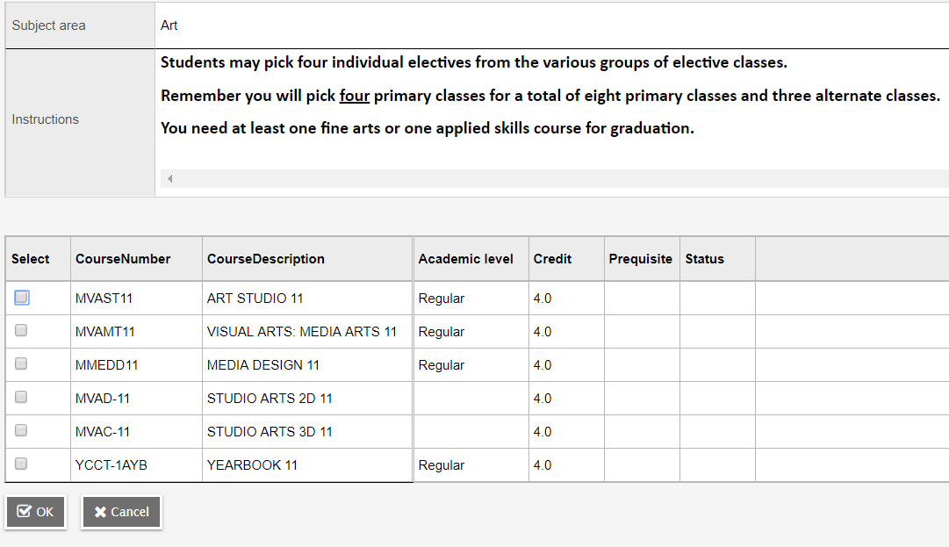
Students work your way through the course selection buttons. FI students only pick three more courses for a total of eight primary courses.

Slide 16
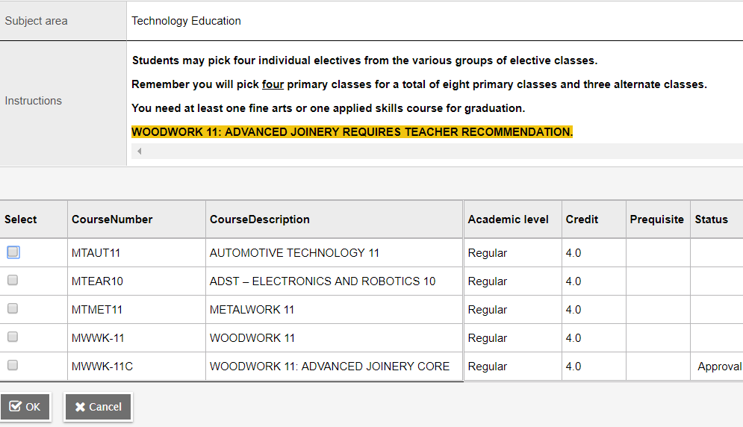
The timetable is built based on student request. It is therefore very important to choose courses carefully as changing requests after the timetable is built is extremely limited.

Slide 17
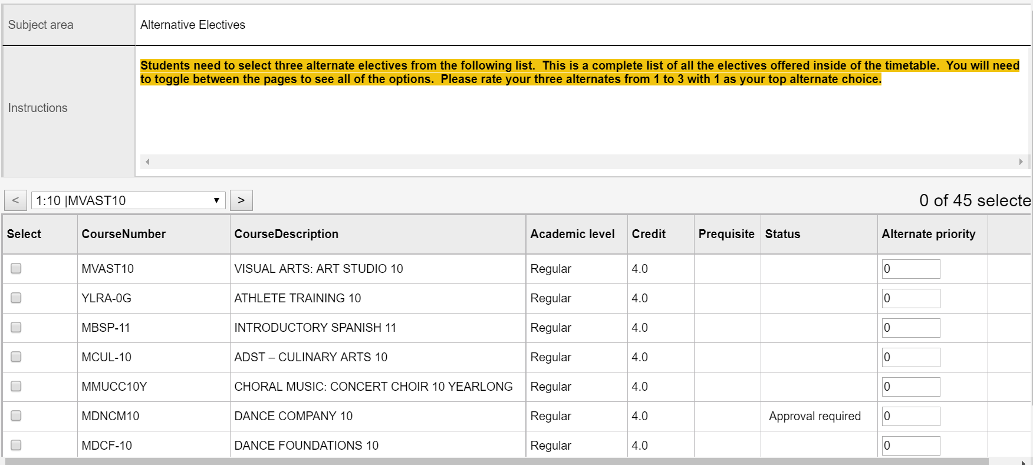
Toggle here
Check number here
Students are asked to select three alternate electives and to rank them in order of priority. Students should toggle through all of the courses to ensure that they are making the correct selection for themselves.

Slide 18
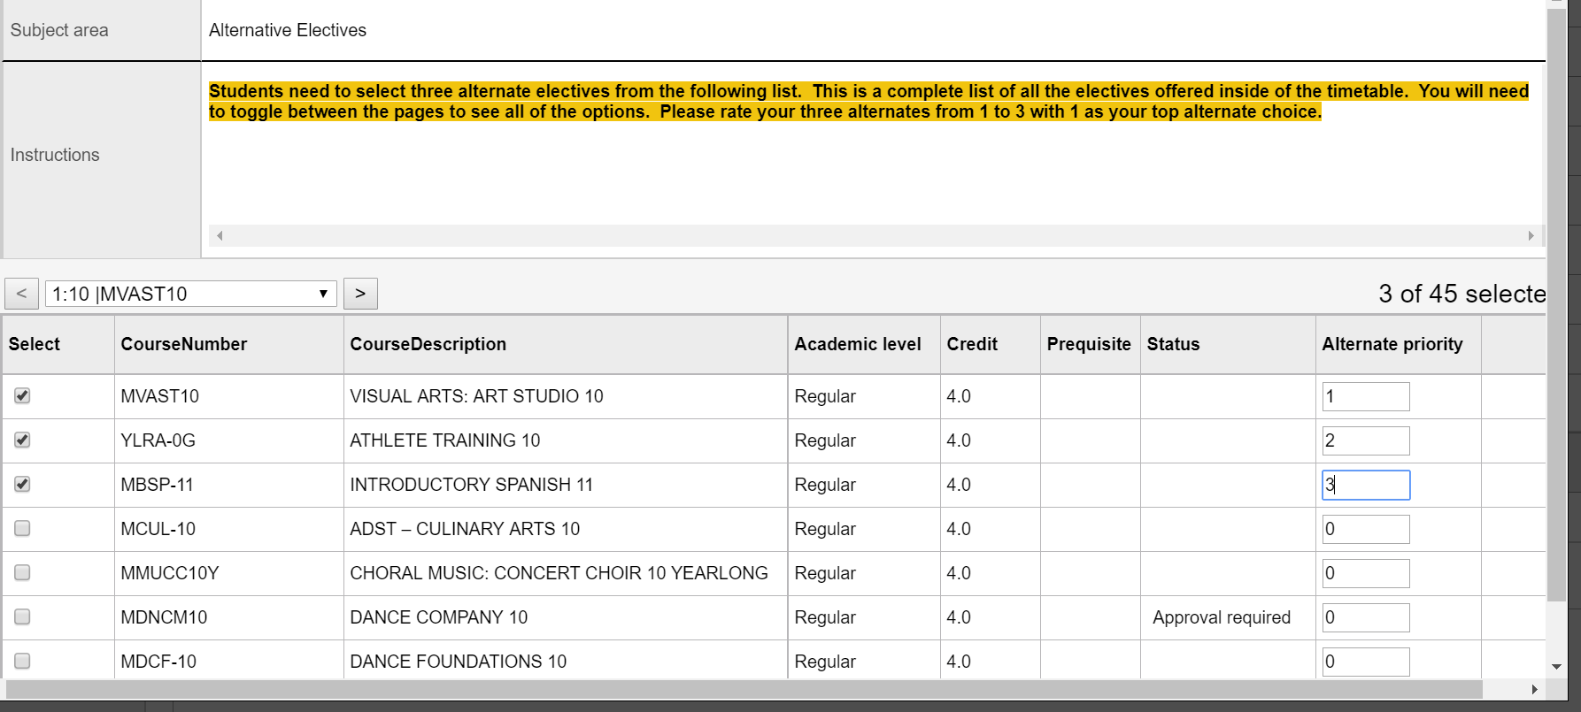
This is an example of three alternate electives selected by checking the box on the left of the elective and ranking them in the column on the right.
Ranking from 1 to 3
Select three alternate electives by checking the corresponding box and rank them in order of priority

Slide 19
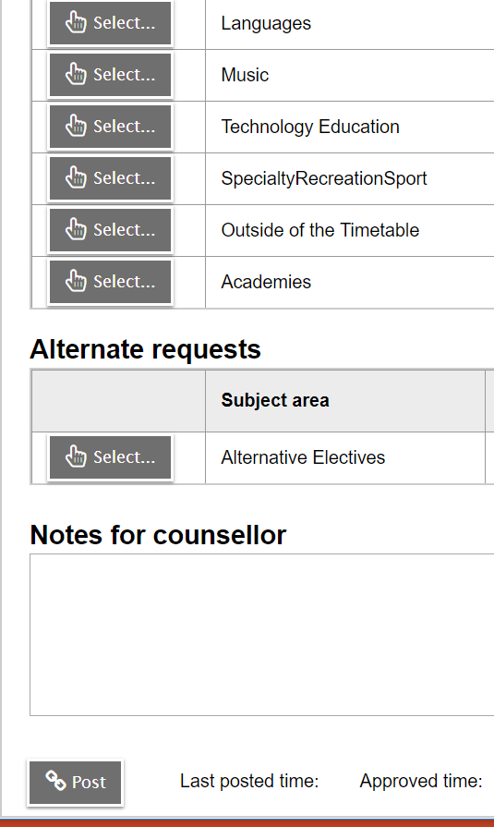
Students may leave a note for their counsellor if they want a course that they cannot select. Students can log in to MyEdBC as often as they wish while the course selection window is open.
Select Courses from various groupings
Select 3 Alternate Courses
Notes for counsellor regarding courses you want or special circumstances
Make sure you post your selection
Students need to press the post button on the bottom of the page to save their selection

Slide 20
All students should have a minimum of 8 primary and 3 alternate courses. Students that select outside of the timetable courses such as music or cheerleading will have more than 8. Please ignore Scheduled % and Credits. Support blocks and Peer Tutor blocks are not selected at this time.

