Slide 1
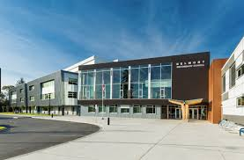
Welcome to Belmont Secondary Online Course Selection Grade 9 - 2021/2022

Slide 2
Online Course Selection
You will need your MyEd Portal login information provided by your teacher/school.
Login ID is your student number
Password is temporary and you will create a new one. Keep this private and accessible
If you do not have a Login ID/password, please email agunn@sd62.bc.ca
You must use a computer the first time you log into MyEd or your account will be disabled!

Slide 3
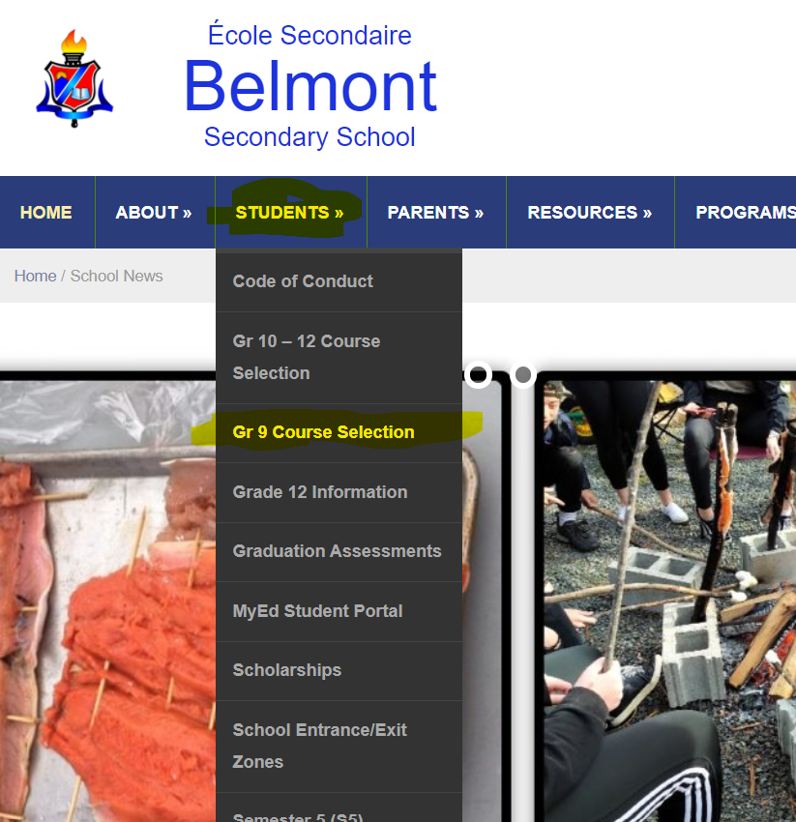
Course Selection Sheet
The course selection sheet lists all of the grade 9 courses.
The course selection sheet is available on the Belmont website, under Students -> Gr 9 Course Selection
All grade 9 students take English 9, Math 9, Science 9, Social Studies 9 and Physical and Health Education 9.
Students select 3 elective classes and 2 alternate classes.
Students select their courses on line. The web address is listed on the last page of this presentation.

Slide 4
MyEdBC Login
Students create and write down a password prior to attempting to log in to the MyEdBC portal.
The password should be a minimum of 8 characters long, have both upper and lower case letters and a number and a symbol.
Login should be done on a computer for the first time or the account will be disabled. Trying to log in with your phone will disable the account.
Student should be very careful when entering login information as the account will be disabled after more than two inaccurate attempts.
Students will enter an email that they use for password recovery. Use the email that you use most frequently
Students select security question.

Slide 5
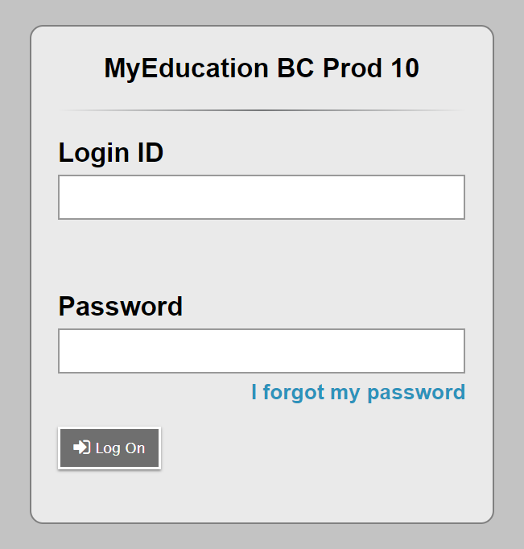
Your First Time Logging in must be with a computer!!
Student number
Temporary Password
Be accurate

Slide 6
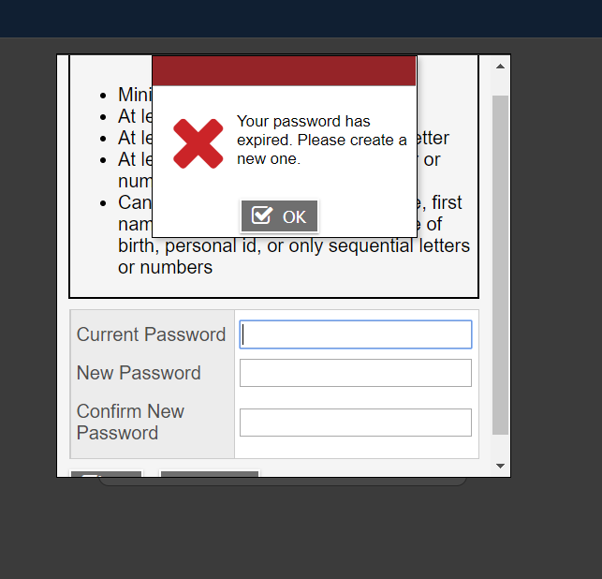
This will be your first successful login!!
Temporary Password Again
Enter your new password
Enter your new password again

Slide 7
Next Step
You will be asked for an email address. Enter the email that you use most frequently. You need this for password recovery.
You will then select a security question, such as what city were you born in.

Slide 8
Student number
Password
8 Characters long, upper and lower case, a number and a symbol
If you forget password click here! Trying more than twice will lock you out.

Slide 9
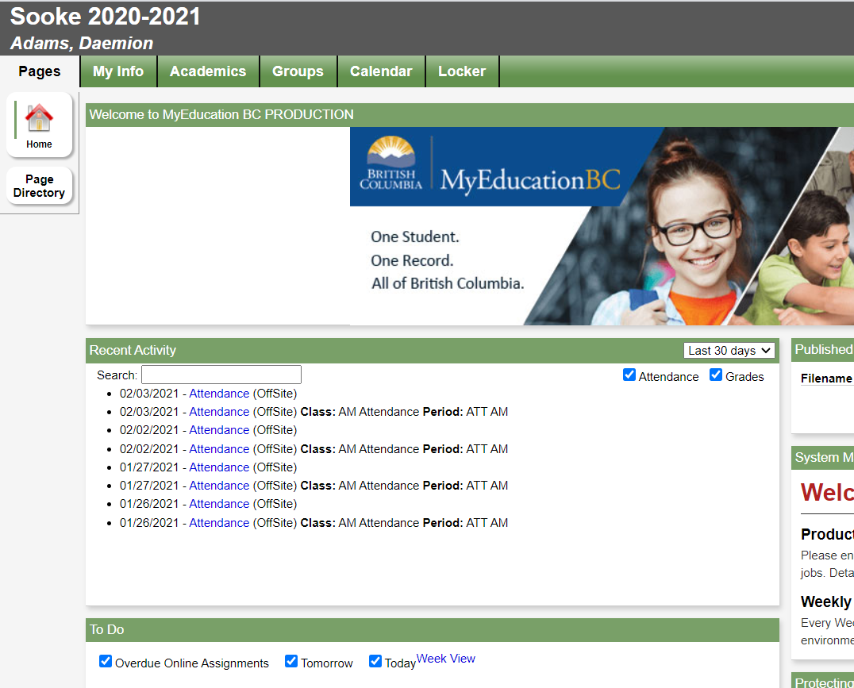
This is the page that you get to when you log into your account.
Click My Info Tab
Danger Dan

Slide 10
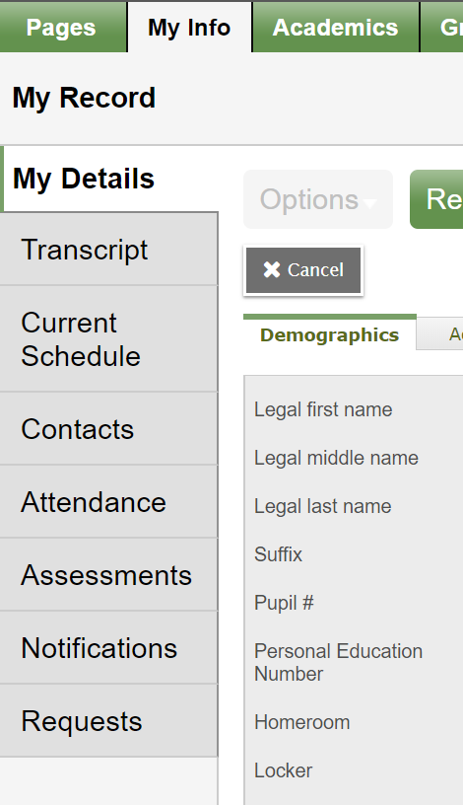
From the my info page select the Requests button at the bottom of the menu on the left.
Click the Requests Tab

Slide 11
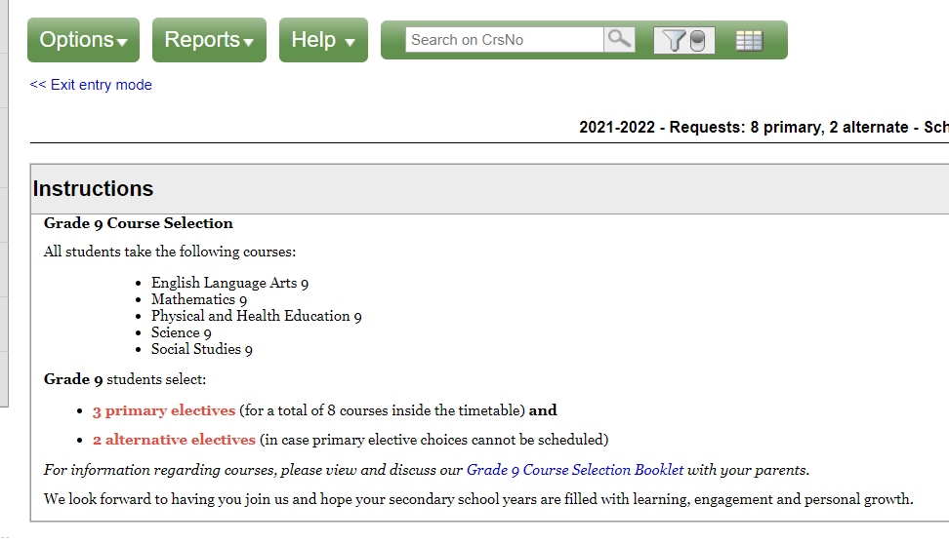
Read the Instructions! Read the Belmont Course Booklet!
All Grade 9 students take these courses
All Grade 9 student select three electives and two different alternates
Link to Course Booklet

Slide 12
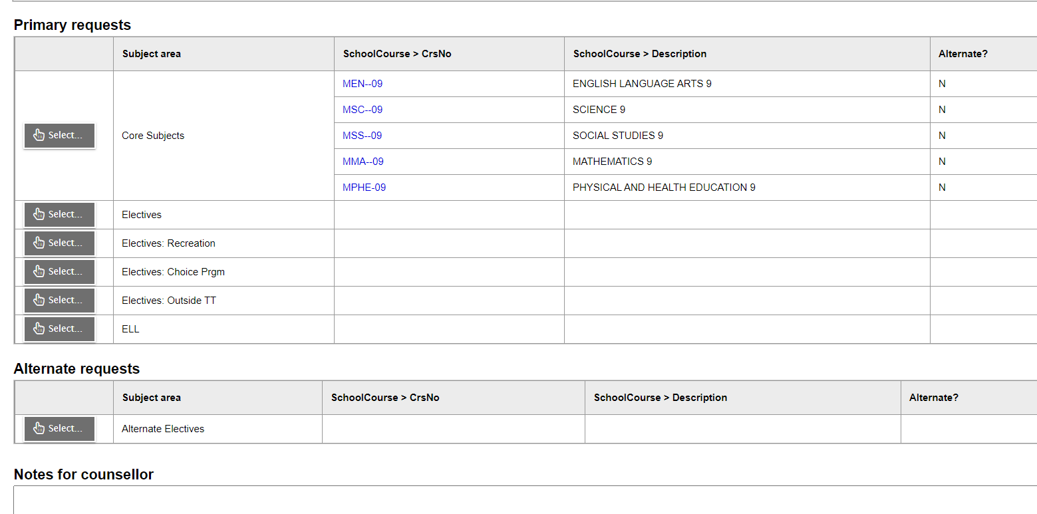
Course selection buttons are on the left side below
the instructions

Slide 13
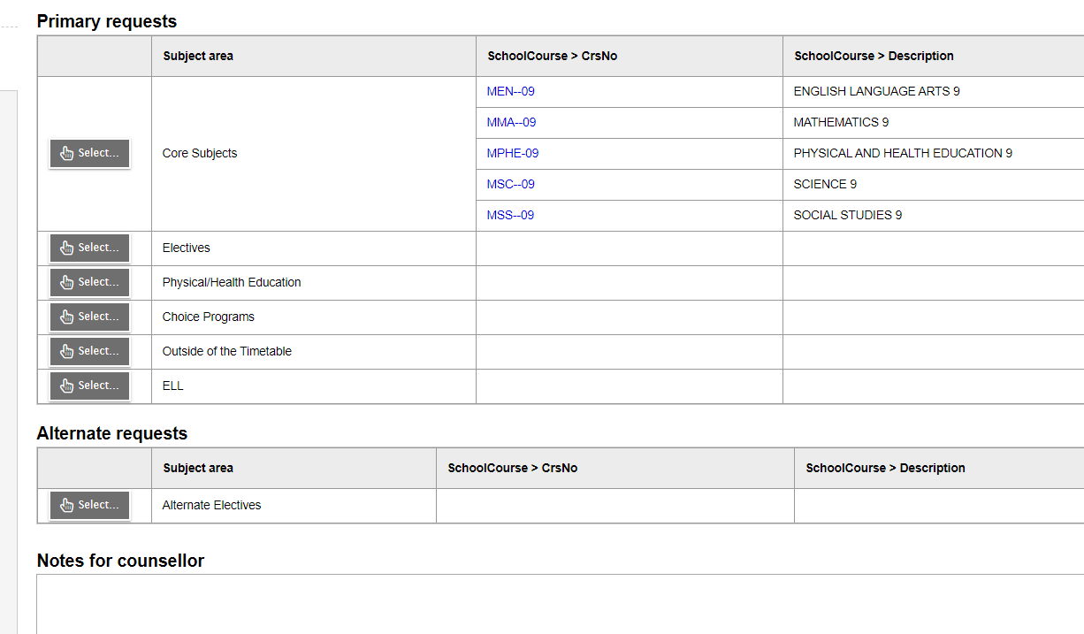
Below the instructions are a set of course selection buttons
Click on Course selection buttons to select course
Select 3 Elective classes
Select 2 different alternate electives
Leave a note for counsellor here

Slide 14
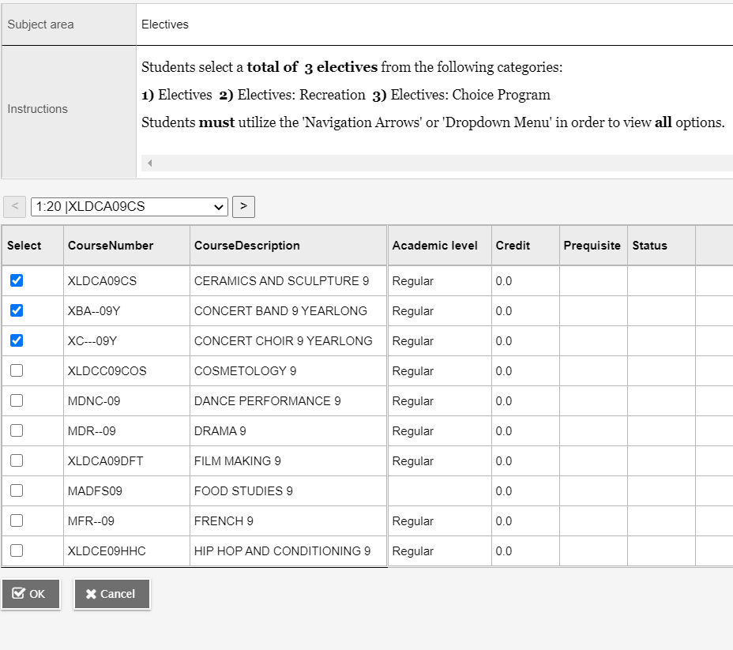
Once you click a selection button you will have another set of instructions and the option of selecting courses in that section by checking the boxes. Complete by clicking OK

Slide 15
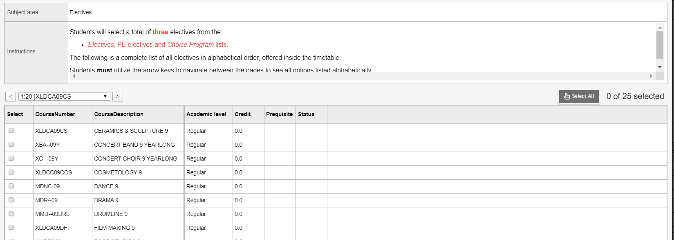
You may need to toggle between pages or use the scroll bars on the sides or bottoms of windows to see all of the options or instructions
Toggle here
Check number here

Slide 16
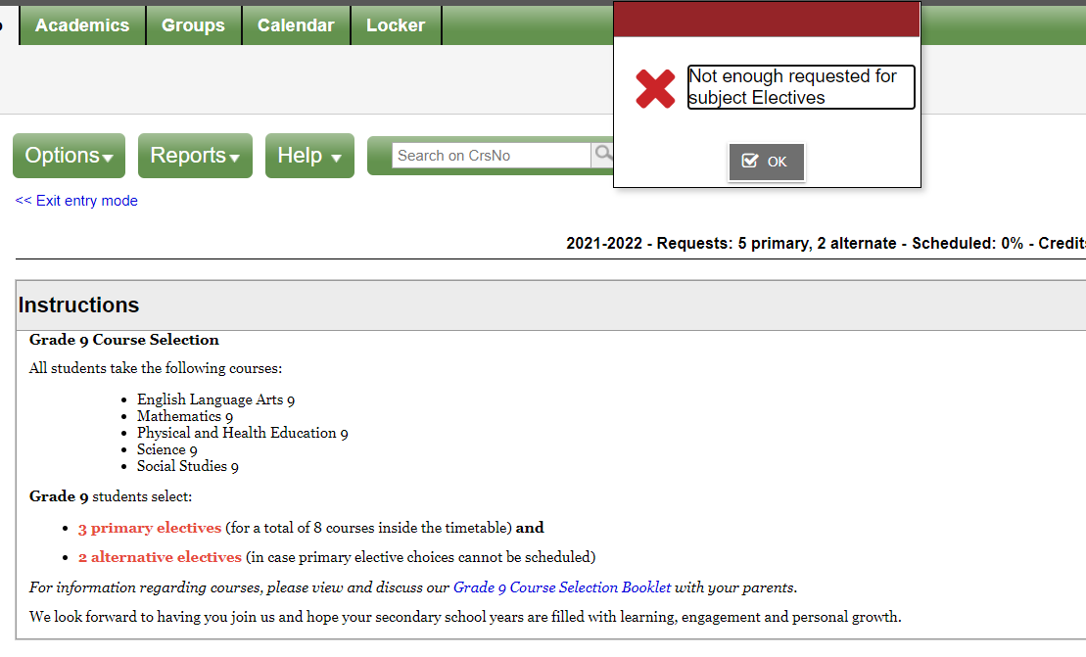
The red banner indicates an error while a green banner indicates success.

Slide 17
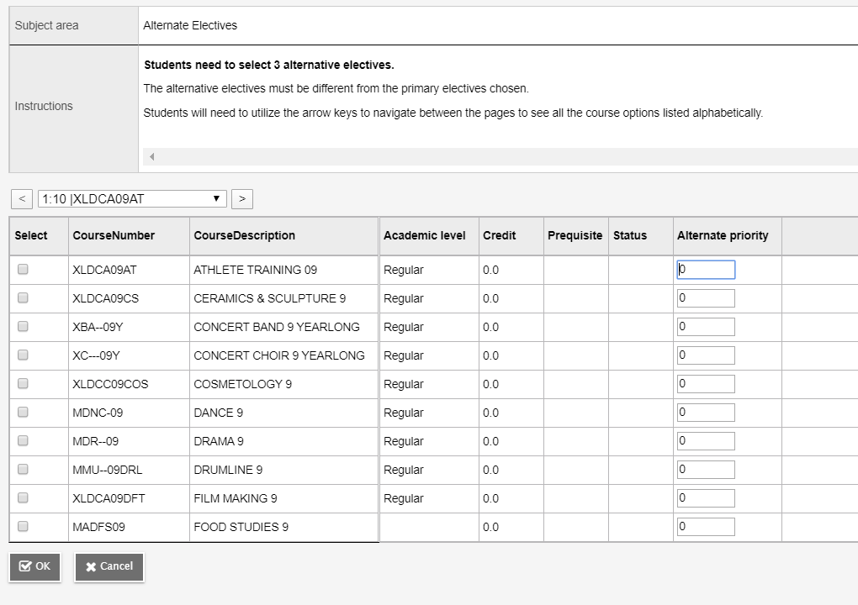
All Students need to select two different alternative electives.

Slide 18
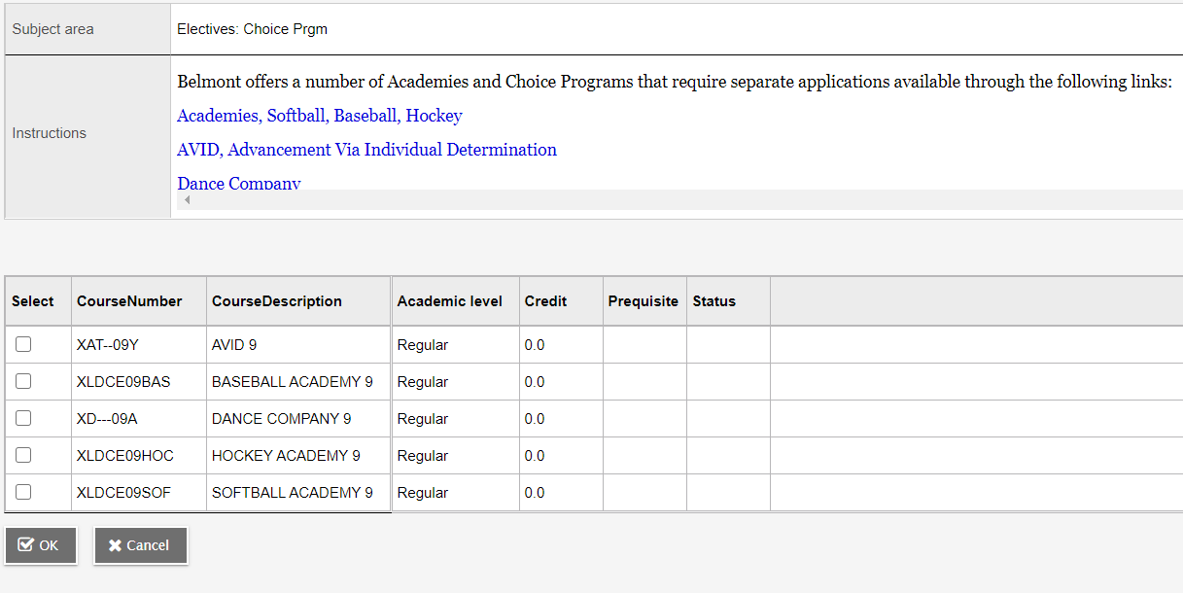
Choice Program require separate applications

Slide 19
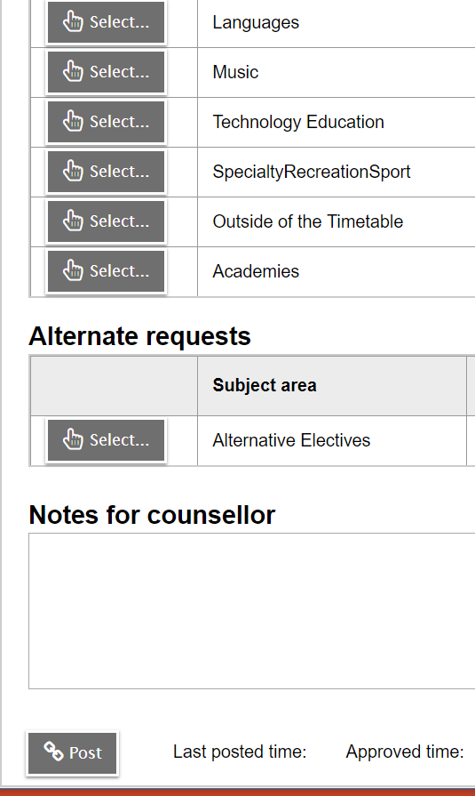
Select Electives from various groupings
Select 2 Alternate Electives and
Notes for counsellor regarding courses you want or special circumstances
Make sure you post your selection

Slide 20
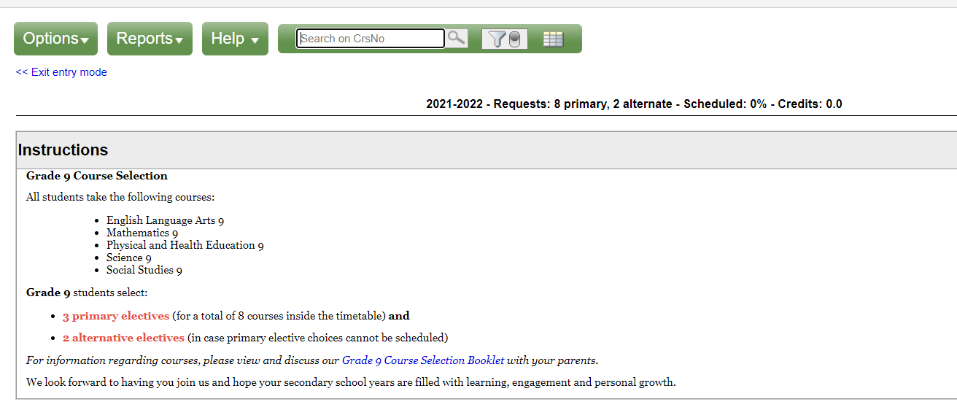
All students should have a minimum of 8 primary and 2 alternate courses. Students that select outside of the timetable courses will have more. Please ignore Scheduled % and Credits. A green banner when you click the post button will indicate success!!

Slide 21
Once you are ready to login please go to the following website:
https://www.myeducation.gov.bc.ca/aspen/logon.do
The course selection portal will remain open for one week.
Remember only try loging in two times if you are not sure about your password or your account will be disabled.
(Hint) Use the forgot password button
You can email Ms.Bodman if your account is disabled and she will reset the password for you which will be emailed to you.
cbodman@sd62.bc.ca
Thank you

