Slide 1
MyEd Course Selection instructions Grade 10

Slide 2
Step 1: Log in to MyEd Student Portal
Go to https://myeducation.gov.bc.ca/aspen/logon.do
Login ID: full Belmont student number
Forgotten Password?
enter your LOGIN ID and click “I forgot my password”.
A new temporary password will be emailed to you.
Disabled Account?
Email: belmontmyedportalsupport@sd62.bc.ca for assistance. Be sure to include your first and last name, and your full student number.

Slide 3
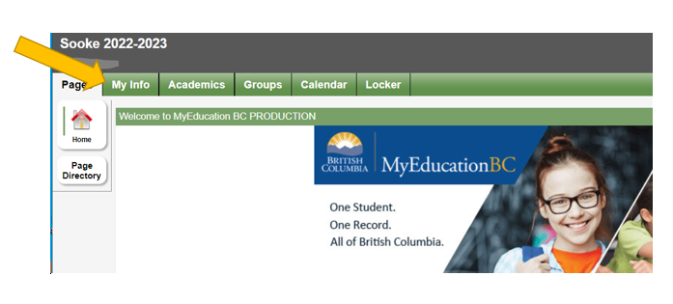
Once logged in you will see this page
(If using a phone – need to click “view full site”)
Click the “My Info” tab

Slide 4
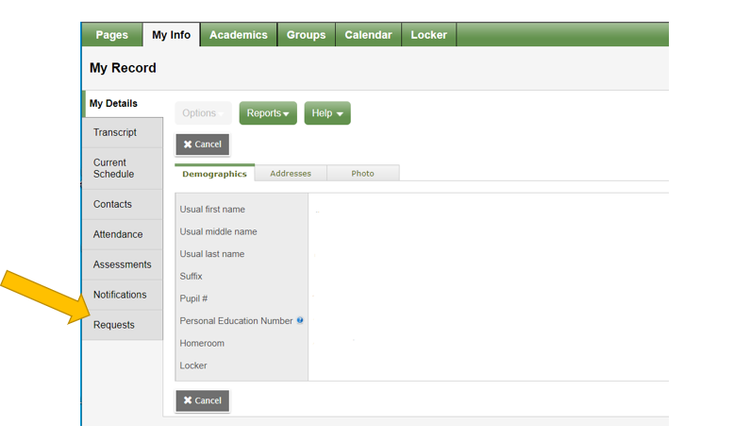
Next: Click the “Requests” button (on the left side menu)

Slide 5
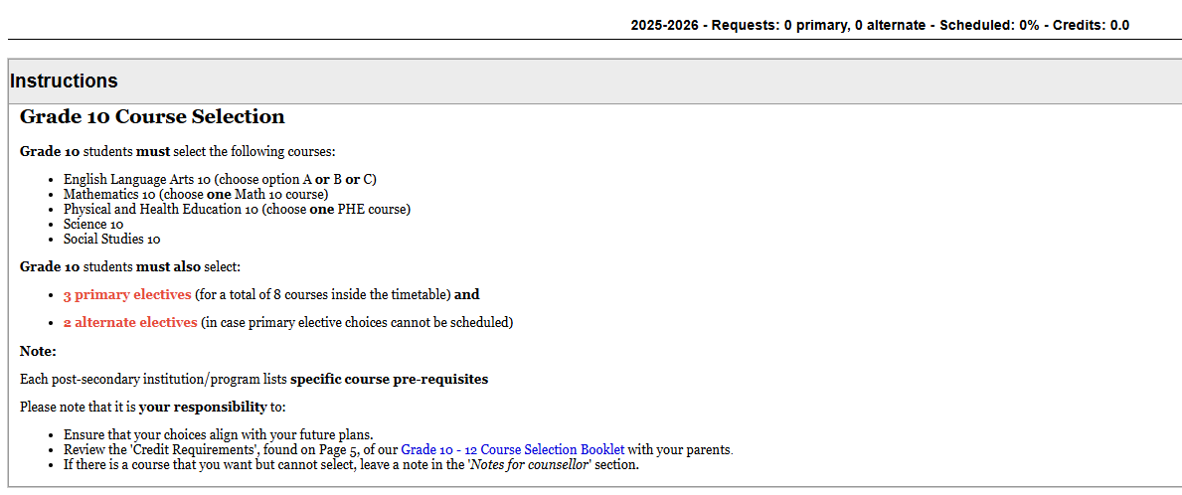
The next screen will begin with some instructions for the grade you are going into .
Please read carefully, then begin to scroll down.

Slide 6
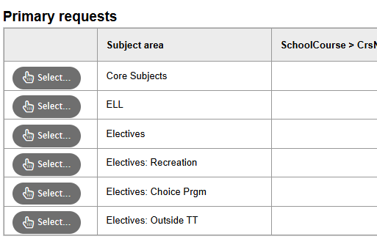
Core Subjects - See slide next slide (# 7)
ELL – Only for ELL students - see slide #8
Can only have a total of 3 Electives combined from the “Electives” sections
See slide # 9-10
See slide # 11
See slide # 12
Optional / extra courses - See slide # 13

Slide 7
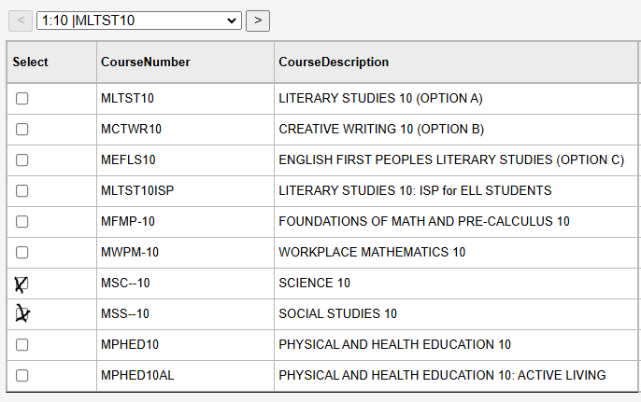
Core Subjects
Click the ‘next page’ arrow to see online options
Pick only ONE (1) English option
*ISP for International or ELL students only
Pick only ONE (1) Math option
Science and Social Studies will be picked for you. If not, please click both.
Pick only ONE (1) Phys Ed option
After all selections made – click OK

Slide 8
ELL (for English Language Learners only) * if English is NOT your first language
Click the box,
then click “OK”

Slide 9
Under “Electives” tabs, click through the pages and select your top 3 choices for electives, then click “ok” at the bottom.
Click “>” to go to the next page
Depending on the device you’re using, there may be a few more options below the screen, so please hold the cursor over the right side border to activate the slide bar to reveal a few more classes on that page.

Slide 10
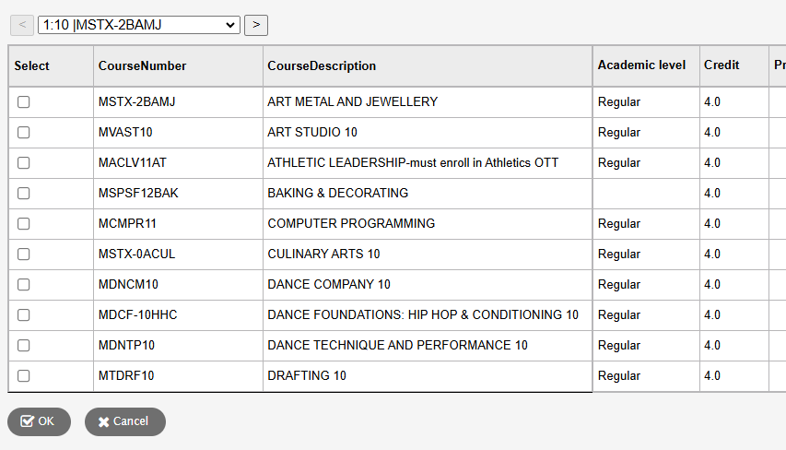
Electives
Reminder – you can only pick a total of 3 electives combined from the “Electives” sections
Click the box next to the class(es) you are want to request.
Then click “OK”

Slide 11
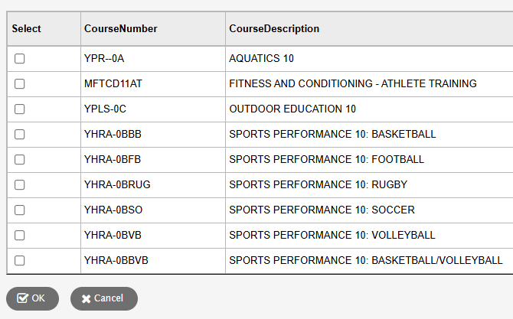
Elective: Recreation
Reminder – you should only pick one (1) “sports performance” course.
You can take 2, but you'll only get credit for one – which may affect your graduation status.
Click the box next to the class(es) you are want to request.
Then click “OK”

Slide 12
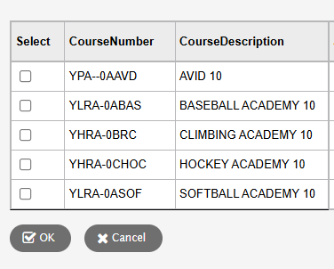
Electives: Choice Programs
Click the box next to the class(es) you are want to request.
Then click “OK”
Reminder – these courses count as 2 electives each and will need a separate application submitted. Click Academies or AVID for more information.

Slide 13
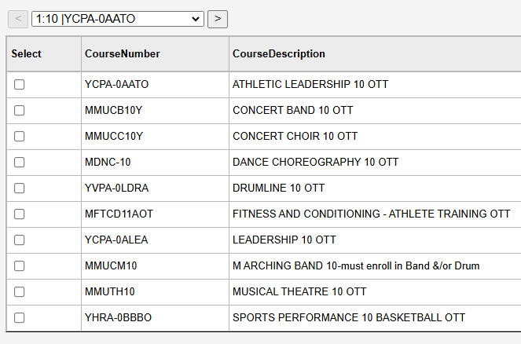
Electives: Outside the Timetable (Optional)
Click the box next to the class(es) you are want to request.
Then click “OK”
These are OPTIONAL, EXTRA courses you can choose to take. They run before and/or after school on certain days.

Slide 14
Alternate Elective Requests
You will NOT get all of your 1st choice electives, so please enter 2 or more different alternate electives.
entering the same course(s) in both ‘elective’ and ‘alternate’ sections will NOT guarantee you will get the course.
not entering any alternates will NOT guarantee you will get only your 1st choices.
All that does it let the computer system put you into whatever course has space, and you may be stuck with it. Therefore, you only help yourself by entering 2 or more different alternate electives.

Slide 15
Notes for your counsellor
IF there’s anything your counsellor needs to know when adjusting your timetable for next year – please type it in this section.
For Example:
I’m taking Construction TASK in semester 2
I plan to take ________ in the summer
Some other electives I would like are _______, _________
please don’t put “make sure I have classes with (a specific teacher) or (your friend’s name here)” We are not able to make those accommodations.

Slide 16
Once you’ve made your selections in each of the appropriate categories,
Then click “Post” to submit your course selection.

Slide 17
Once you click “POST” - if you did it correctly, you will see a green pop-up box with a green check mark.
If not done correctly, or missing something, you will see a red pop-up box with a red X.
You may need to add or delete an elective
Or forgot a core subject

Slide 18
You can make changes to course requests until the window closes.
IF you make any changes – make sure to always click ‘Post’ each time – to save the updated requests.

Slide 19
Once the request window is closed, you have to go to your counsellor to make changes. If you have any questions or need assistance contact your counsellor.
students with LAST names starting with: | Counsellor (click name to book appointment) | Email
A – E | Todd Robertson | TRobertson@sd62.bc.ca
F – L | Michele Kiefert | mkiefert@sd62.bc.ca
M-P | Ryan Lieser | rlieser@sd62.bc.ca
Q – Z | Rachael Sandberg | rsandberg@sd62.bc.ca

